Slide 1
PowerShell + SQL Server = Better Together

Slide 2

Get-Help –Name ‘about_Presenter’
Mike F Robbins
Mississippi PowerShell User Group
PowerShell Conference Book
PowerShell 101: The No-Nonsense Beginner’s Guide
Windows PowerShell TFM 4th Edition
PowerShell Deep Dives
Advanced Category in the 2013 Scripting Games
Learn more about me @ mikefrobbins.com
Notes:
Microsoft MVP on Windows PowerShell
Leader & Co-Founder of Mississippi PowerShell User Group
Author of PowerShell 101: The No-Nonsense Beginner’s Guide
Co-Author of Windows PowerShell TFM 4th Edition
Author of Chapter 6 in the PowerShell Deep Dives book
Winner of the Advanced Category in the 2013 Scripting Games
Learn more about me @ mikefrobbins.com

Slide 3
Write-Output ‘Questions for Audience’
IT Pro’s
Developers
Unit Testing
Source Control
VSCode (Visual Studio Code)
ISE (Integrated Scripting Environment)
PowerShell Core
PowerShell Experts
Notes:
VSCode is a free opensource and lightweight program that’s the new and improved replacement for the PowerShell ISE.
VSCode –ne Visual Studio
PowerShell Core is not an upgrade or replacement to Windows PowerShell. It installs side by side on Windows based systems.

Slide 4

Start-Process ‘Demo’
Demo Code: github.com/mikefrobbins/Presentations

Slide 5
Select-Object –Property ‘Resources’
PowerShell Documentation
PowerShell Best Practices and Style Guide
PowerShell.org
Planet PowerShell
User Groups
PowerShell Community Videos
Twitter
Slack
Trello

Slide 6





Get-Contact –Identity ‘Presenter’
Blog: mikefrobbins.com (or MrPowerShell.com)
Twitter: @mikefrobbins
LinkedIn: www.linkedin.com/in/mikefrobbins
E-Mail: See mikefrobbins.com/about/
User Group: mspsug.com (or MsPowerShell.com)

Slide 7
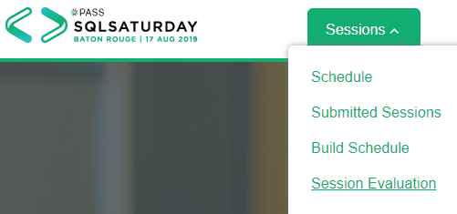
Session Evaluations are ONLINE ONLY
Your feedback is valuable!
SQLSatBR.com/Sessions/SessionEvaluation.aspx

